Slide 1
Mobile and Accessories Management Shop
Prof.R.H.Borhade
Head of Department
SOMYA ANCHALIA (T120368627)
ROHAN WADE (T120368637)
SAURABH SHETE (T120368620)
Dr S.N.Gujar
Guide
Department of Information Technology

Slide 2
We would like to express our special thanks of gratitude to our teacher Dr.S.N.Gujar as well as our Head of Department Prof.R.H.Borhade who gave us golden opportunity to do this wonderful project on the topic Mobile and Accessories Shop Management System which also helped me in doing a lot of Research in the subject of Database Management System and we came to know about
so many new things and we are really thankful to them.
We carried out this project as we observed that there were less amount of informative database software for the Mobile and Accessories Shop management system .More accurate information plus exact knowledge of hospital management can be well obtained by our project .Focus is made on all features of it.

Slide 3
Abstract
The Mobile Store Management System is software which can become the backbone for a billing and inventory system for small organizations. This software provides an uncomplicated system
to run mobile stores. This application could be very useful to small organizations. This application is inspired from current pen and paper based store management systems. It will provide an easy and attractive interface so that the user can easily manage and utilize the application. Various other approaches were considered for this application. This application is
designed in a way that it will only require a minimum amount of information from the user. The goal was to look for the minimum amount of information that will meet needed requirements.
Also this system is useful for Administration Department of the shop in order to keep the track of their Employees. Also this system is very useful for the employees working in the store for keeping track of the stocks left in the store

Slide 4
LIST OF TABLES
Table No. | Title | Page No
6.1 | Basic Information of Accessories | 17-19
6.2 | Basic Information of all devices | 17-19
6.3 | Basic Information of all Employees | 17-19
6.4 6.5 6.6 6.7 6.8 6.9 6.10 6.11 6.12 | Calculation of Margin Login Information of Administrator Name of Cities Basic Information of all Customers Login Information of Employee Basic Information of Mobiles Information about damaged android phones Information about damaged apple phones Information about customers having damaged phones | 17-19 17-19 17-19 17-19 17-19 17-19 17-19 17-19 17-19

Slide 5
LIST OF FORMS
Figure No. | Title | Page No
1.1 | Form to add device | 20
1.2 | Form to add employee | 21
1.3 | Admin Page Form | 21
1.4 | Forgot Password Form | 22
1.5 | Admin_ID Form | 22
1.6 | Admin Login Form | 23
1.7 | Admin Forget Password | 23
1.8 | Admin Login | 24
1.9 | Create Bill | 24
1.10 | Customer Info | 25
1.11 | Employee Page Form | 25
1.12 | Employee Forget Password | 26
1.13 | Employee_ID Form | 26
1.14 | Employee Login Form | 27
1.15 | Login Form | 27\
1.25 | View damaged phones Form | 32

Slide 6
And some acronyms are…
bno CName C_ID
CMobile CCity CAddress DOB
Emp
Bill Number Customer Name Customer Id
Customer’s Mobile Number City of Customer
Address of Customer Date Of Birth
Employee

Slide 7
E-R DIAGRAM
`
Adhar_no
CHECKS FOR
Quantity
Price
Model
Emp_name
Mob_no
Address
MOBILE
Tax
Quantity
DOB
EMPLOYEE
GIVES
Date
Price
E_ID
Quantity
Price
REQUIRE
Model
Model
BILL
Total
ACCESSORIES
Bill_no
PERFORMS
Model
Cost_price
Selling Price
CUSTOMER
CALCULATES
MARGIN
Mob_no
REQUIRES
Cust_name
City
Address
Cust_ID
Cust_name
Date
Priice
Status
Model
REPAIR AND MAINTAINANCE
Query

Slide 8
TABLES
ENTITY | ATTRIBUTES
Add_devic | Type,Model,Price,Quantity,Specifications
Add_emp | Name,DOB,Adharno,Mobileno,Address
Add_margi | Type,Model,Costprice,Sellingprice,Margin
Admin | Username,Password,Hint
Customer_ | Date,Type,Model,Price,Quantity,Cname,CMobile,CAddress,CCity,Total,Billno
Repair_mo | C_ID,Name,Type,Model,Price,Query,Status
Mob_repair | Type,Phone

Slide 9
FORMS

Slide 10

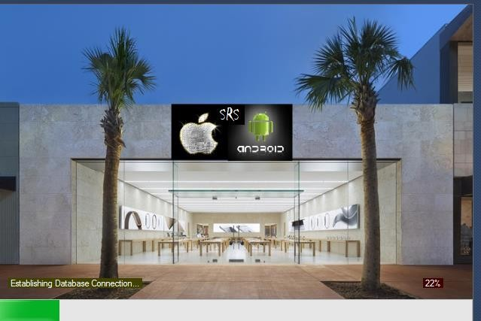

Slide 11
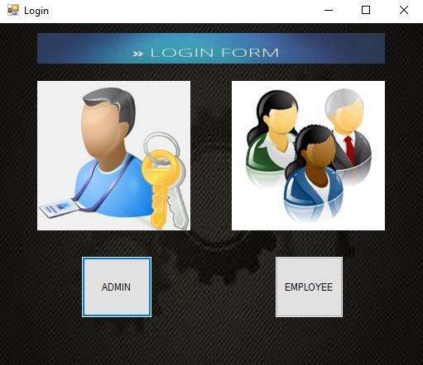

Slide 12
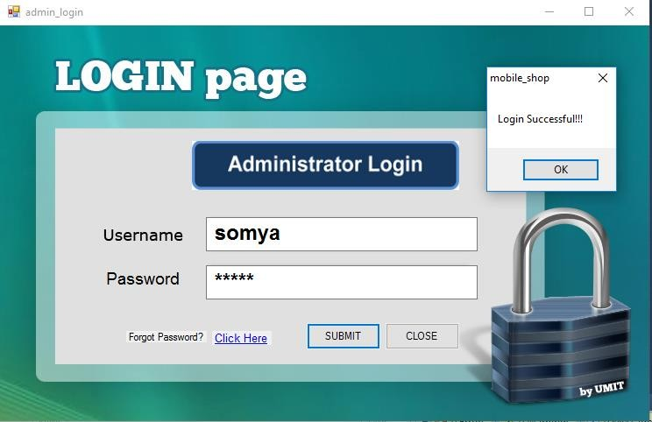

Slide 13
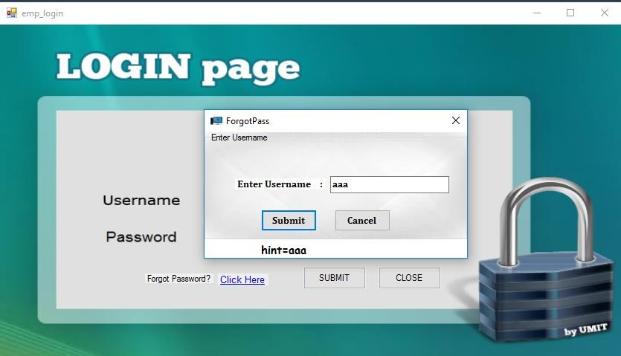

Slide 14
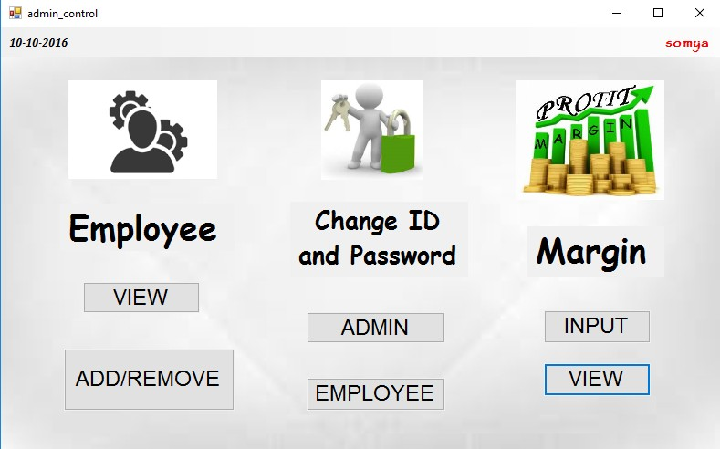

Slide 15
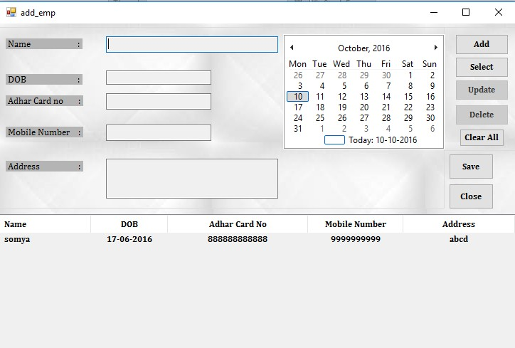

Slide 16
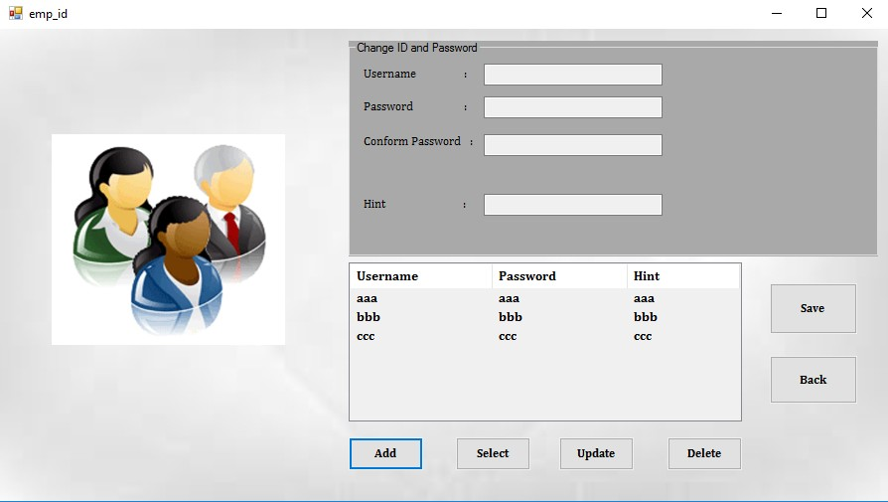

Slide 17
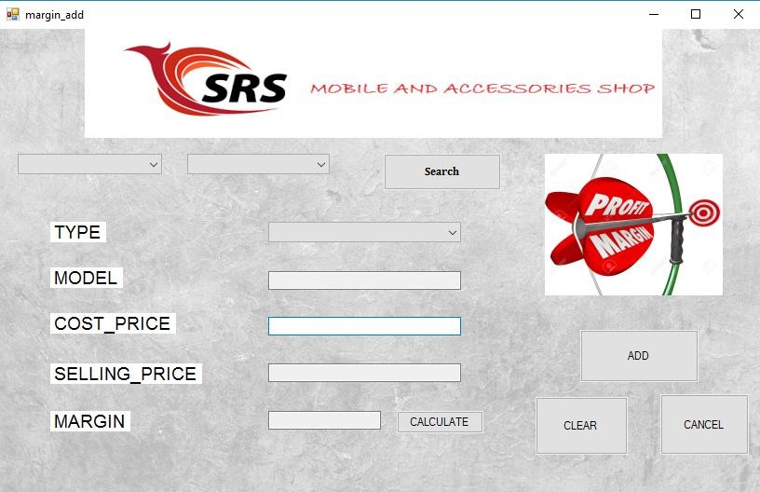

Slide 18
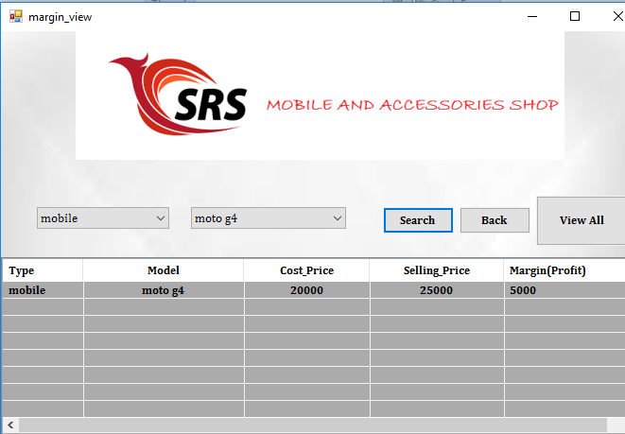

Slide 19
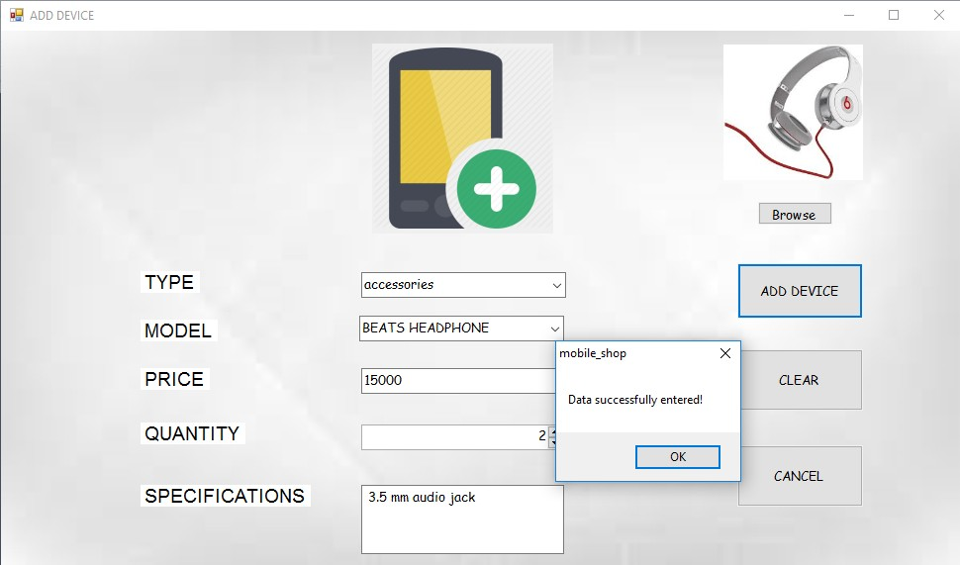

Slide 20
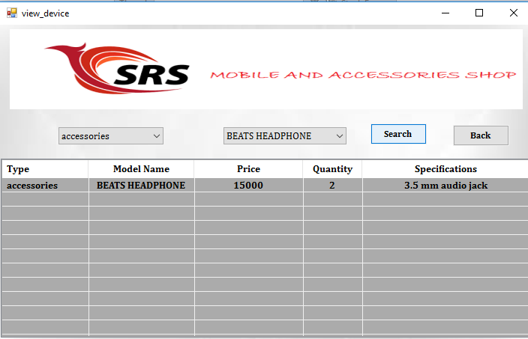

Slide 21
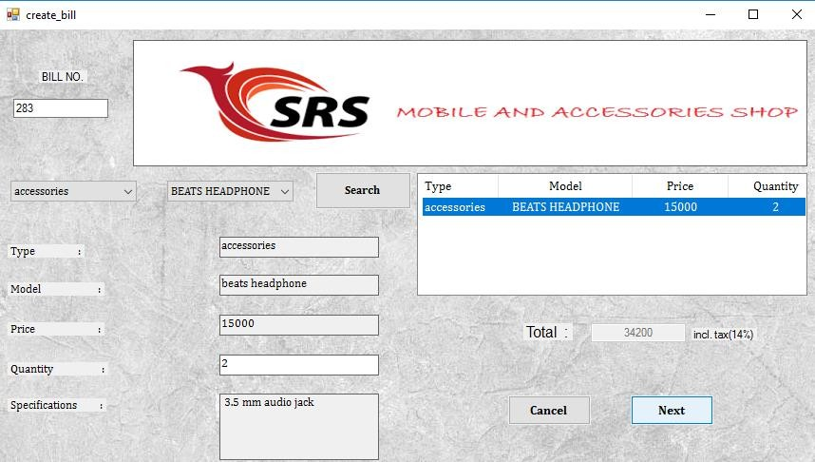

Slide 22
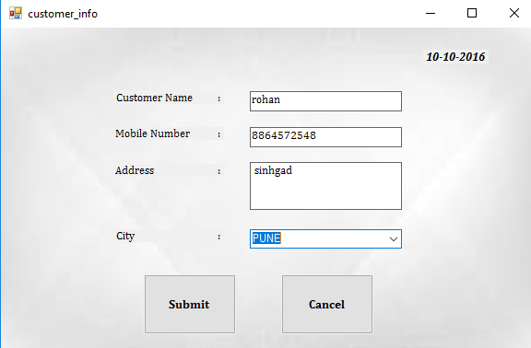

Slide 23
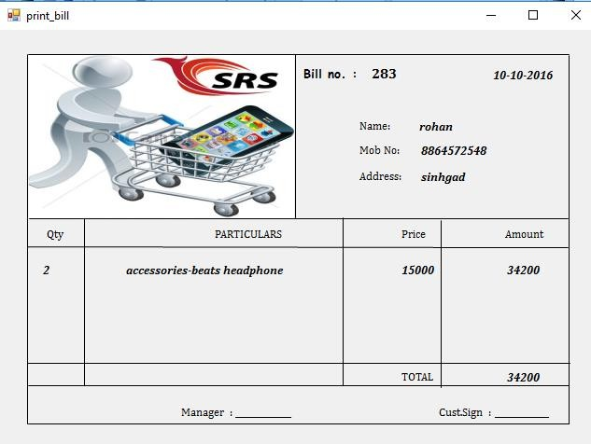

Slide 24
Projects and solutions are at the core of any work you do with Visual Studio .NET. Projects represent individual components or applications. Solutions are collections of related projects. Solutions can manage the dependencies between projects,ensuring that components are built in the correct order and copied into the rightplaces. Of course, a solution and its projects would be of no use at all if they didn't contain source code of some kind, so in the next chapter we will look at the features in Visual Studio .NET designed to help you edit individual files.
CONCLUSION

Slide 25
REFERENCES
www.Net-tutorials.com
http://www.tutorialspoint.com/mongodb/
3.Silberschatz A., Korth H., Sudarshan S., "Database System Concepts", 4th Edition, McGraw Hill Publishers
4. Agus Kurniawan,”MongoDB Succinctly”, Syncfusion

Slide 26
THANK YOU

